Slide 1
Tenses
SHIVANI M. (PDP Dept.)

Slide 2
Tense
Read the following sentences:
I write this letter to please you.
I wrote that letter in his very presence.
I shall write another letter tomorrow.
In sentence 1, the verb write refers to present time.
In sentence 2, the verb wrote refers to past time.
In sentence 3, the verb shall write refers to future time.
Thus a verb may refer:
To present time, (Present Tense)
To past time, or (Past Tense)
To future time. (Future Tense)

Slide 3
Read these sentences:
I love. (Simple Present)
I am loving. (Present Continuous)
I have loved. (Present Perfect)
I have been loving. (Present Perfect Continuous)
In sentence 1, the verb shows that the action is mentioned simply, without anything being said about the completeness or incompleteness of the action.
In sentence 2, the verb shows that the action is mentioned as incomplete or continuous, i.e., as still going on.
In sentence 3, the verb shows that the action is mentioned as finished, complete, or perfect at the time of speaking.
In sentence 4, the verb shows that the action is mentioned as going on continuously, and not completed at this present moment.

Slide 4
Just as the Present Tense has four forms the Past Tense has also the following forms:
I loved. (Simple Past)
I was loving. (Past Continuous)
I had loved. (Past Perfect)
I had been loving. (Past Perfect Continuous)
Similarly, the Future Tense has the following four forms:
I shall love. (Simple Future)
I shall be loving. (Future Continuous)
I shall have loved. (Future Perfect)
I shall have been loving. (Future Perfect Continuous)
We may now define Tense as that form of a verb which shows the time and the state of an action.

Slide 5
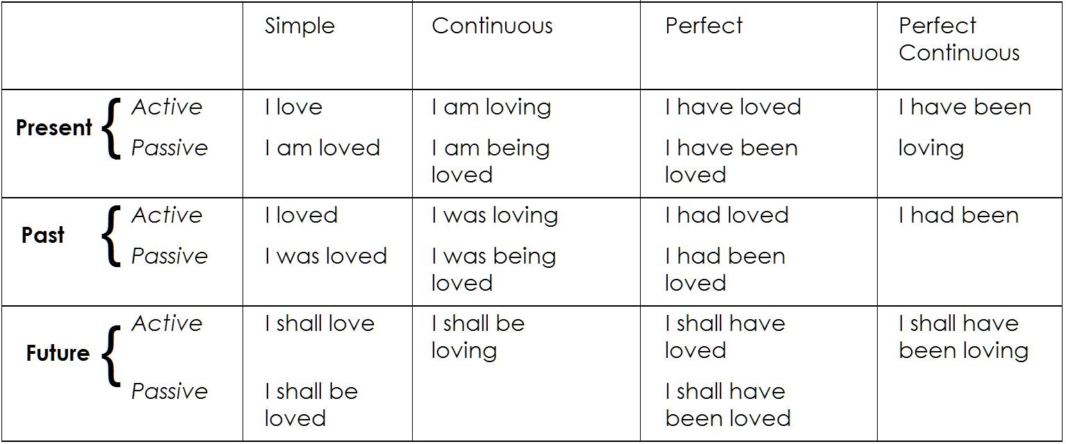
Carefully study the following table of Tenses of Verb to love.
It will be seen that there are twelve tenses in Active Voice, and eight in the Passive Voice.

Slide 6
Simple Present Tense
To express a habitual action; as,
He takes milk every morning.
I get up every day at five o’clock
My watch keeps good time.
To express general truths; as,
The sun rises in the east.
Honey is sweet.
Fortune favors the brave.
In exclamatory sentences beginning with ‘here’ and ‘there’ to express what is actually taking place in the present; as,
Here the comes the bus!
There she goes!

Slide 7
In vivid narrative, as substitute for the Simple Past; as,
Susan nor rushes forward and deals a heavy blow to Peter.
Immediately the Sultan hurries to his capita.
To indicate a future event that is part of a plan or arrangement;
They leave for London by the next mail.
When does the college reopen?
To introduce quotations; as,
Keats says, ‘A thing of beauty is a joy for ever’.
It is used, instead of the Simple Future Tense, in clauses of time and of condition; as,
I shall wait till you finish your lunch.
If it rains we shall get wet.
As in broadcast commentaries on sporting events, the Simple Present is used, instead of the Present Continuous, to describe activities in progress where there is stress on the succession of happenings rather than on the duration.

Slide 8
Present Continuous Tense
For an action going on at the time of speaking; as,
She is singing (now).
The boys are playing hockey.
For a temporary action which may not be actually happening at the time of speaking; as,
I am reading ‘David Copperfield’ (but I am not reading at this moment).
For an action that is planned or arranged to take place in the near future.
I am going to the cinema tonight.
My uncle is arriving tomorrow.

Slide 9
It has been pointed out before that the Simple Present is used for a habitual action. However, when the reference is to a particularly obstinate habit (something which persist, e.g., in spite of advice or warning) we use the Present Continuous with an adverb like always, continually, constantly.
My dog is very silly; he is always running out into the road.
The following verbs, on account of their meaning, are not normally used in the continuous form:
Verbs of perception, e.g., see, hear, smell, notice, recognize.
Verbs of appearing, e.g., appear, look, seem.
Verbs of emotion, e.g., want, wish, desire, feel, like, love, hate, hope, refuse, prefer.
Verbs of thinking, e.g., think, suppose, believe, agree, consider, trust, remember, forget, know, understand, imagine, mean mind.

Slide 10
Have (=posses), own, possess, belong to, contain, consist of, be (except when used in the passive).
These verbs are used in the Simple Present, they may, however, be used in the continuous tenses with a chance of meaning ; as,
I am thinking of (=considering the idea of) going to America.
Mr. Singh is minding (=looking after) the baby while his wife is out shopping.

Slide 11
Present Perfect Tense
To indicate completed activities in the immediate past; as,
He has just gone out.
It has just struck ten.
To express past actions whose time is not given and not definite; as,
Have you read ‘Gulliver’s Travels’?
I have never known him to be angry.
Mr. Harry has been to Japan.
To describe past events when we think more of their effect in the present than of the action itself; as,
Gollum has eaten all the biscuits (i.e., there aren’t any left for you).
I have finished my work (= now I am free).
I have cut my finger (and it is bleeding now).

Slide 12
To denote an action beginning at some time in the past and continuing up to the present moment; as,
I have known him for a long time.
He has been ill since last week.
We haven’t seen Peter for several months.
The following adverbs (or adverb phrases) can be used with the Present Perfect: just, often, never, ever (in questions only), so far, till now, yet (in negatives and questions), already, since – phrases, for – phrases, today, this week, this month etc.
Note that the Present Perfect is never used with adverbs of past time. We should not say, e.g., ‘He has gone to Calcutta yesterday’. In such case the Simple Past should be used; ‘He went to Calcutta yesterday’.

Slide 13
Present Perfect Continuous Tense
The present perfect continuous is used for an action which began at some time in the past and is still continuing; as,
He has been sleeping for five hours ( and is still sleeping).
They have been building the bridge for several months.
They have been playing since 4 o’clock.
This tense sometimes used for an action already finished. In such cases the continuity of the activity is emphasized as an explanation of something.
‘Why are your clothes so wet?’ –– I have been watering the garden.

Slide 14
Simple Past Tense
It is used to indicate an action completed in the past. It often occurs with adverbs or adverb phrases of past time.
I received his letters a week ago.
She left school last year.
The streamer sailed yesterday.
Sometimes it is used without an adverb of time. In such case the time may be either implied or indicated by the context.
I didn’t sleep well (i.e., last night).
I learnt Hindi in Nagpur.
Babar defeated Rana Sanga at Kanawha.
The Simple Present is also used for past habits; as,
He studied many hours every day.
She always carried an umbrella.

Slide 15
Past Continuous Tense
The Past Continuous is used to denote an action going on at some time in the past. The time of action may or may not be indicated.
We were listening to the radio all evening.
It was getting darker.
The light went out while I was reading.
When I saw him, he was playing chess.
This tense is also used with always, continually, etc., for persistent habits in the past.

Slide 16
Past Perfect Tense
The past Perfect Tense describes an action completed before a certain moment in the past; as,
I met him in new Delhi. I had seen him last five years before.
If two actions happened in the past, it may be necessary to show which action happened earlier than the other. The Past Perfect is mainly used in such situations. The Simple Past is used in one clause and the Past Perfect in the other; as
When I reached the station the train had started (so I couldn’t get into the train).
I had done my exercise when Harry came to see me.
I had written the letter before he arrived.

Slide 17
Past Perfect Continuous Tense
The Past Perfect Continuous is used for an action that began before a certain point in the past and continued up to that time; as,
At that time he had been writing a novel for two months.
When Mr. Malcolm cane to the school in 1965, Mr. Andrew had already been teaching there for five years.

Slide 18
Simple Future Tense
The Simple Future is used for an action that has still to take place; as,
I shall see him tomorrow.
Tomorrow will be Sunday.
Note that the Simple Future Tense generally expresses pure or colorless future. When the future is colored with intention, the going to + infinitive construction is preferred, e.g.;
He is going to build a new house.

Slide 19
Future Continuous Tense
The future continuous represents an action as going on at some time in future time; as,
I shall be reading the paper then.
When I get home, my children will be playing.
This tense is also used for future events that are planned; as,
I’ll be staying here till Sunday.
He will be meeting us next week.

Slide 20
Future Continuous Perfect Tense
Future Perfect Tense
The Future Perfect is used to indicate the completion of an action by a certain future time; as,
I shall have written my exercise by that time.
Before you go see him, he will have left the place.
The Future Perfect Continuous indicates an action represented as being in progress over a period over a period of time that will end in the future; as,
By next July we shall have been living here for six years.
When he gets his degree, he will have been studying at Oxford for four years.

Slide 21
The End

